Slide 1
Nature’s Bomb
A Human-AI Collaborative Music Project by
GANTASMO
Presented by Noel Li
MTEC-345-001

Slide 2
Project Overview
GANTASMO: Daniel Joaquin Trujillo's AI music project (2018-2019)
Collaboration with Sarah Maynard
Aim: Raising awareness about environmental destruction and animal suffering

Slide 3

Song Concepts
Theme: Animals witnessing habitat devastation
Innovative approach: combining natural beauty with human-made destruction
Technical highlight: AI integration in lyrics, sound design, and vocals

Slide 4

Creative Process

Slide 5
1.Lyric development
AI collaboration: ChatGPT and Llama 3
Human-AI iterative refinement process

Slide 6
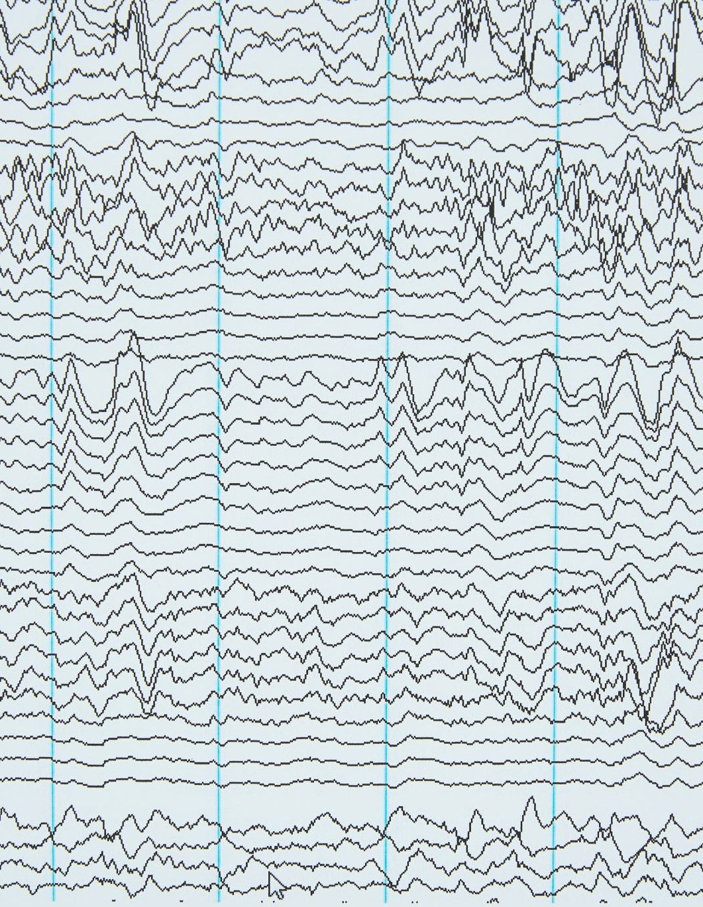
2.Sound design
Audio sample collection: Natural sounds (whale songs, extinct species vocalizations)
Human-made sounds (nuclear tests, gunfire, fracking)
Sample processing with StableAudio。

Slide 7

-StableAudio
StableAudio is an AI-powered audio generation tool developed by Stability AI. It's designed to create high-quality, original music and sound effects using artificial intelligence technology.
Core Architecture:
StableAudio likely uses a combination of advanced machine learning models, including:
Transformer-based models for sequence generation
Generative Adversarial Networks (GANs) for high-quality output
Autoregressive models for sample-by-sample generation

Slide 8
Transformer Models
1.Attention Mechanism:The core innovation of Transformers.
Allows the model to "focus" on the most relevant parts when processing an input sequence.
Analogy: When reading a long article, we pay special attention to key words and important paragraphs.
2.Self-Attention:
Each element in the input sequence can interact with all other elements in the same sequence.
Enables the model to capture complex relationships within the sequence.
3.Multi-Head Attention:
Performs multiple attention operations simultaneously.
Allows the model to understand the input from different perspectives.
Analogy: Observing an object from multiple angles.
4.Positional Encoding:Since Transformers don't inherently process sequences like RNNs, additional position information is needed.
Adds a unique identifier to each position in the input sequence.

Slide 9

Generative Adversarial Networks (GANs)
How GANs Work
The generator creates new data instances.
The discriminator evaluates these instances along with real data from the training set.
Both networks receive feedback and adjust:
The generator aims to create more convincing outputs.
The discriminator aims to get better at distinguishing real from fake.
This process continues, leading to improvement in both networks.

Slide 10

END

